Slide 1

AfroBeats
Music recommender for the latest hits!

Slide 2

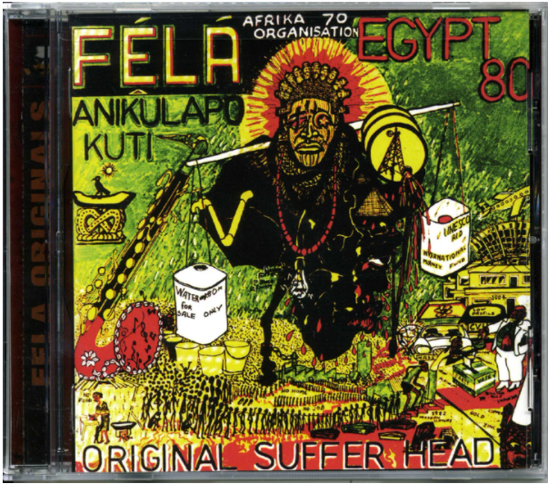
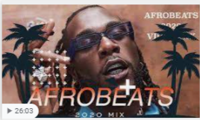
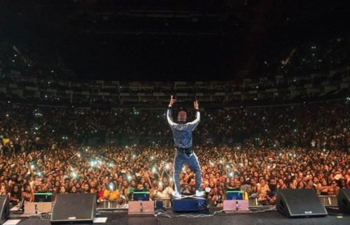

Trend Over Time
Fuji Music
Mix of Jazz, Hip-Hop, and Traditional Music
A Mix of music from all parts of the world:
Jamaica, USA, UK, and African Nations

Slide 3
THE MODEL Error Metrics
Used Official Top 20 Charts
Gathered Playlist Information From Spotify
Used KNN To Cluster Songs by given Audio Features:
Danceability
Energy
Loudness
Speecihiness
Acoustiness
Valence
Tempo
Accuracy Score: 0.61
Accuracry Score with Cross Validation: 0.77 +/ 0.04

Slide 4
For The Future
Work on finding a way to rank songs added to Playlists within time period
Increase Dataset size to train the model better
Recommendation system will also match songs from other Genres

